Slide 1



10 / 04
2024
Tim Spieringhs
Disassembly project

Slide 2

Sprint beloftes
Duidelijk uitslag van onderzoek van verschillende computer vision frameworks
Proof of concepts van bepaalde mogelijke herkenningen

Slide 3
Onderzoek framework computer vision
TensorFlow
PyTorch
Azure AI
OpenCV
Niet YOLO maar wel in gedachte gehouden

Slide 4
TensorFlow
TensorFlow
Aspect | Reasoning | Grading 1-10
Accuracy | Can achieve high accuracy with careful model design and training. | 8
Speed | Slower than OpenCV for basic tasks, but can be optimized for performance. | 7
Community & Support | Large and active community with extensive documentation and resources. | 9
Training Time | Flexible training capabilities, but training complex models can be time-consuming. | 7
Flexibility | Highly flexible for various deep learning tasks. | 9
Ease of Use | Steeper learning curve compared to OpenCV, but good tutorials are available. | 7
Resource Efficiency | Resource usage varies depending on model complexity, but can be optimized. | 7
Total |  | 54

Slide 5
PyTorch
PyTorch
Aspect | Reasoning | Grading 1-10
Accuracy | Similar to TensorFlow in achieving high accuracy with proper model design and training. | 8
Speed | Similar speed considerations as TensorFlow; can be optimized for performance. | 7
Community & Support | Growing and active community with good documentation and resources. | 8
Training Time | Flexible training capabilities, training time depends on model complexity. | 7
Flexibility | Highly flexible for various deep learning tasks. | 9
Ease of Use | Considered slightly more user-friendly than TensorFlow for research. | 8
Resource Efficiency | Similar resource usage considerations as TensorFlow. | 7
Total |  | 54

Slide 6
OpenCV
OpenCV
Aspect | Reasoning | Grading 1-10
Accuracy | Not high if you detect objects with only OpenCV but with YOLO it would be way more accurate | 5
Speed | Fast for computer vision tasks, slower than TensorFlow/PyTorch for deep learning. | 7
Community & Support | Large and active community with extensive resources and tutorials. | 10
Training Time | Limited training capabilities for deep learning models. | 3
Flexibility | Primarily for computer vision tasks, less flexible for general deep learning. | 6
Ease of Use | Beginner-friendly with many tutorials and well-documented functions. | 9
Resource Efficiency | Efficient for computer vision tasks, especially without deep learning models. | 9
Total |  | 49

Slide 7
Azure AI
Azure AI
Aspect | Reasoning | Grading 1-10
Accuracy | Accuracy depends on the specific deep learning service used. | N/A
Speed | Speed varies depending on the service. | N/A
Community & Support | Microsoft provides documentation and support for Azure AI services. | 8
Training Time | Training time depends on the service, dataset size, and hardware used. | N/A
Flexibility | Offers various deep learning services for different tasks, but may not be as flexible as standalone frameworks. | 8
Ease of Use | Can be easier than building models from scratch, but requires familiarity with Azure services. | 8
Resource Efficiency | Pay-as-you-go model for cloud resources, can be efficient if used optimally. | 8
Total |  | N/A

Slide 8
YOLO
YOLO is een algoritme die je kan toevoegen
YOLO heeft een framework nodig
Alle 4 kunnen YOLO toevoegen
YOLO maakt herkkenen sneller
YOLO gebruikt meer CPU/GPU
Veranderd de uitkomst niet

Slide 9
3D scannen POC
Artec EVA 3D scanner
Iphone 15 pro 3D scanner

Slide 10
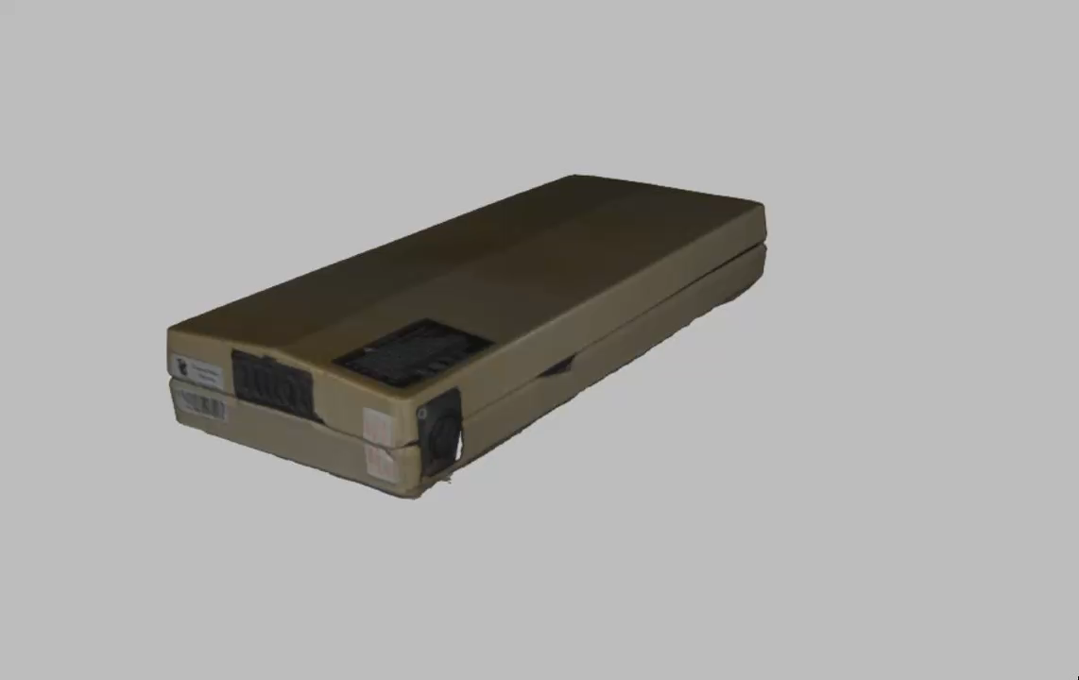
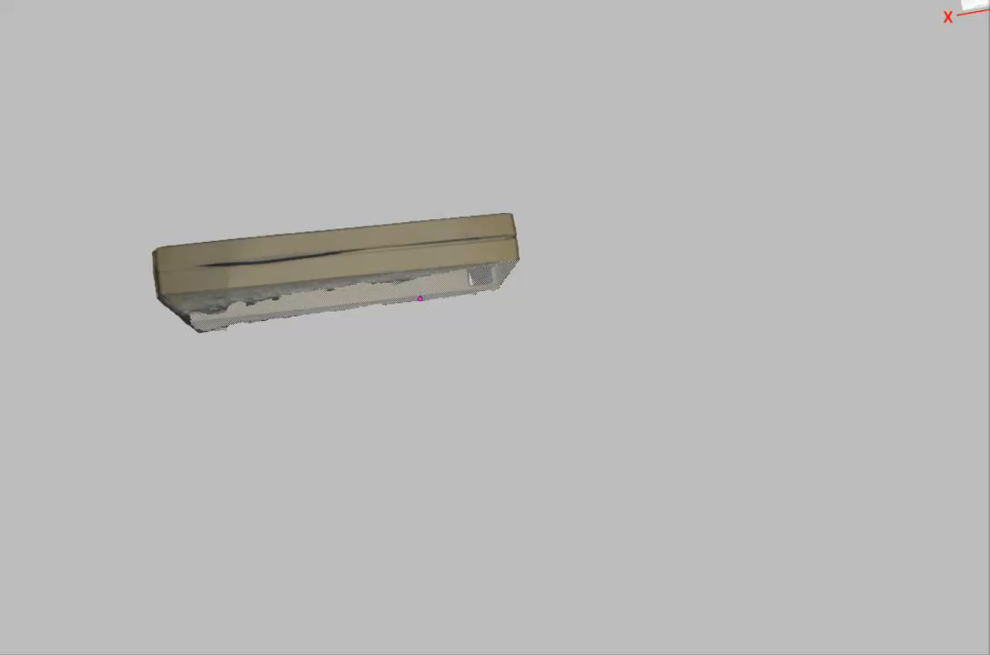
Artec Eva

Slide 11

Iphone 15 pro
Koste veel meer tijd
Ging vaak fout
Moeilijk te editen

Slide 12
Blender
Python script automatisch opnamen
Nog niet getest met gescand product vanwege licentie problemen
To Do:
Automatisch bounding boxes opslaan
Testen met gescand product zodra ik een licentie heb

Slide 13
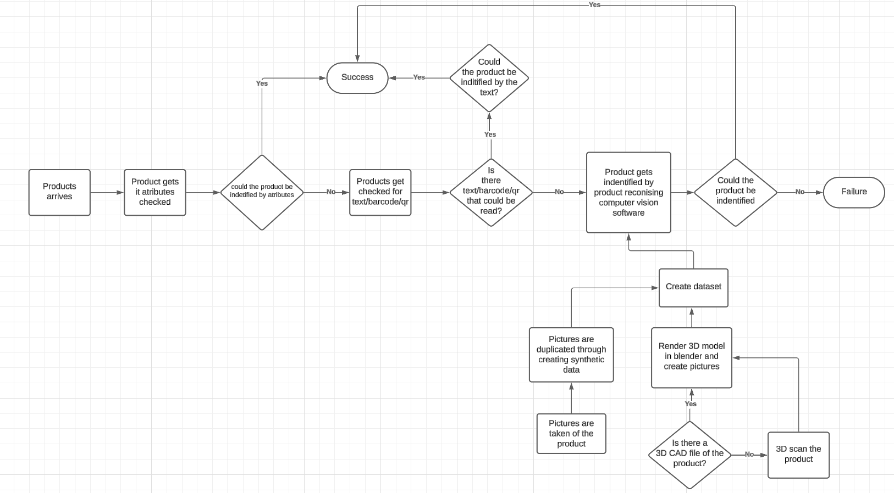
Voorstel voor sprint 2
Afmaken volledige POC zodra ik licentie heb
2de POC voor attributen herkennen (gewicht, kleur en vorm)
Bedrijf bezoek affix en meenemen in onderzoek
Voorstel vanuit PO?

